Slide 1

INFORMATION SESSION
FOR
IMPACT WOMEN’S MINISTRY
2025 RETREAT
Presented by:
Retreat Planning Committee
Sunday, February 2, 2025

Slide 2

MEET YOUR RETREAT PLANNING COMMITTEE (RPC)
RPC TEAM
Ruthie Bass
Carlean Francois
Renee Luster
Yvette Oldacre
Dedicated to serve you.
STEERING COMMITTEE
Dr. Cheryl Anderson
Dr. Michelle Black
Teresa Blueitt

Slide 3


Retreat Theme
We Are BFFs: Bold. Fearless. Faithful. Sisters.
Shining A light For Christ ~Joshua 1:9
Retreat Purpose:
To encourage, equip, and empower women to boldly embrace their faith, overcome fear through God’s strength, and walk faithfully in His purpose.
Through worship, fellowship, and spiritual renewal, we will illuminate His love in our lives and communities, standing together as sisters in Christ.
As bold warriors, we will step forward with confidence; as fearful yet trusting hearts, we will surrender to His plan; and as faithful servants, we will shine His light for the world to see.
Joshua 1:9 – “Have I not commanded you? Be strong and courageous. Do not be afraid; do not be discouraged, for the Lord your God will be with you wherever you go."
Notes:
This verse is a rallying cry for strength, reminding us that God’s presence is the ultimate source of courage.

Slide 4

WHEN & WHERE
October 9-11, 2025
Deposits accepted beginning
February 16, 2025
Jordan Ranch Retreat Center
2123 FM 2238
Schulenburg, TX 78956

Slide 5

Jordan Ranch (Aerial view)

Slide 6
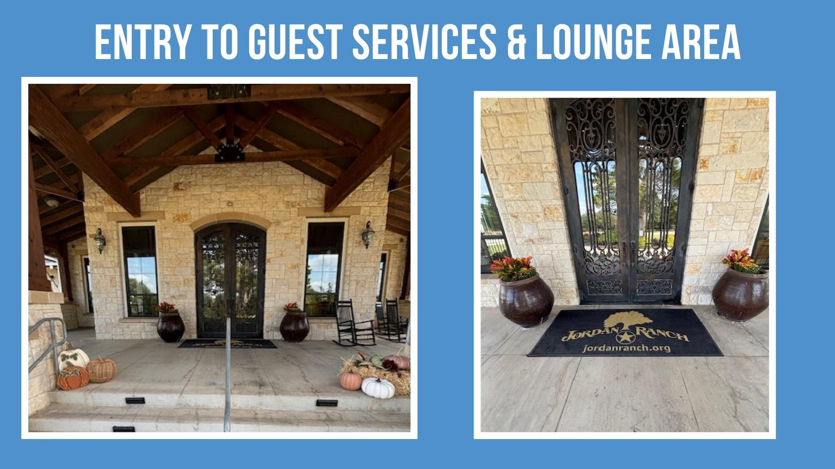
Joshua Ranch Hotel
Entry & Lounge

Slide 7
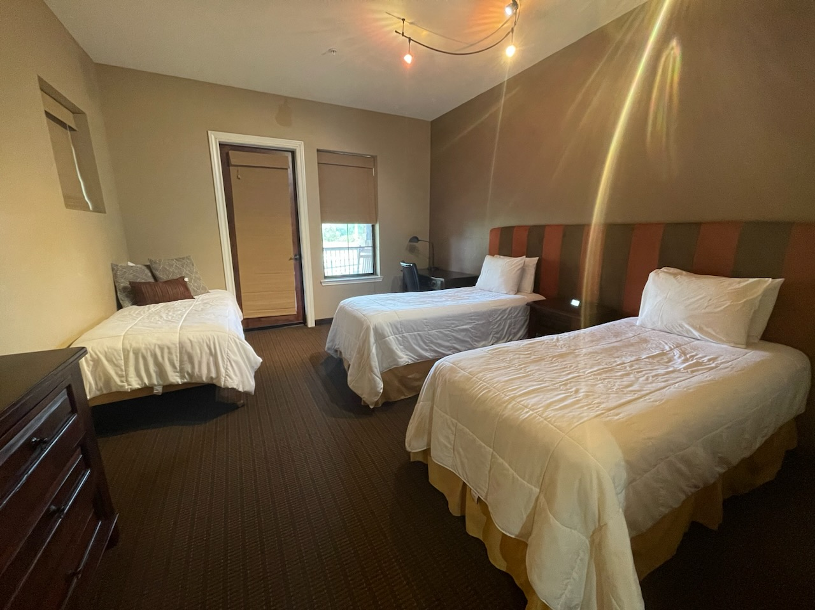
Jordan Ranch Hotel
Sleeping Accommodations
Ages 21+ (no children)
Max 65 women
3 women per room
Space is limited – Register soon

Slide 8


Jordan Ranch Conference Center
Dining & Outdoor Relaxation
Fine Dining
Outside Relaxation Accommodations

Slide 9
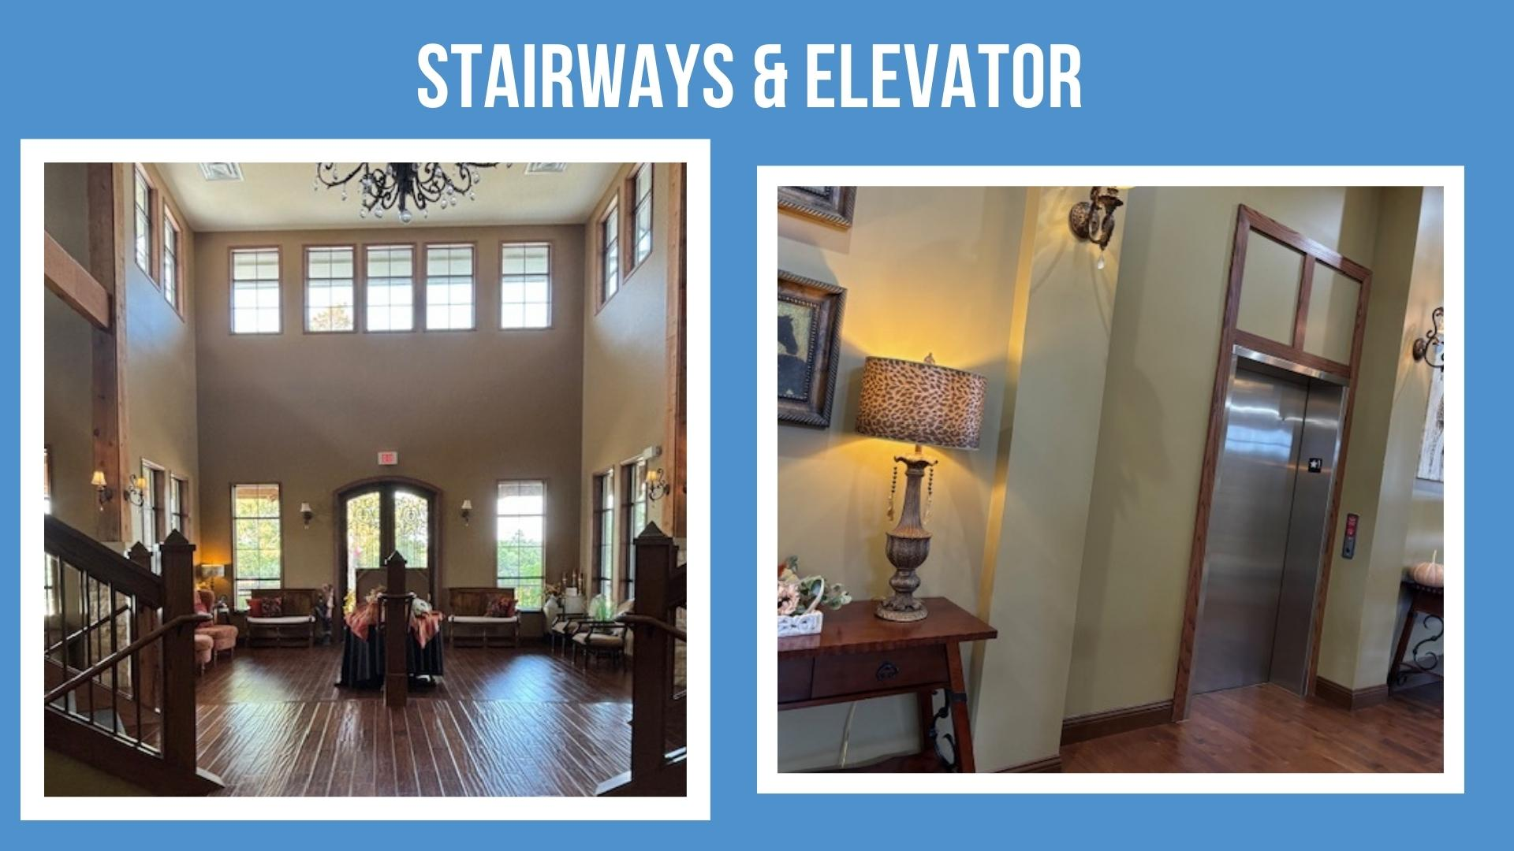
Jordan Ranch Conference Center
Stairways & Elevator to Meeting Destinations

Slide 10
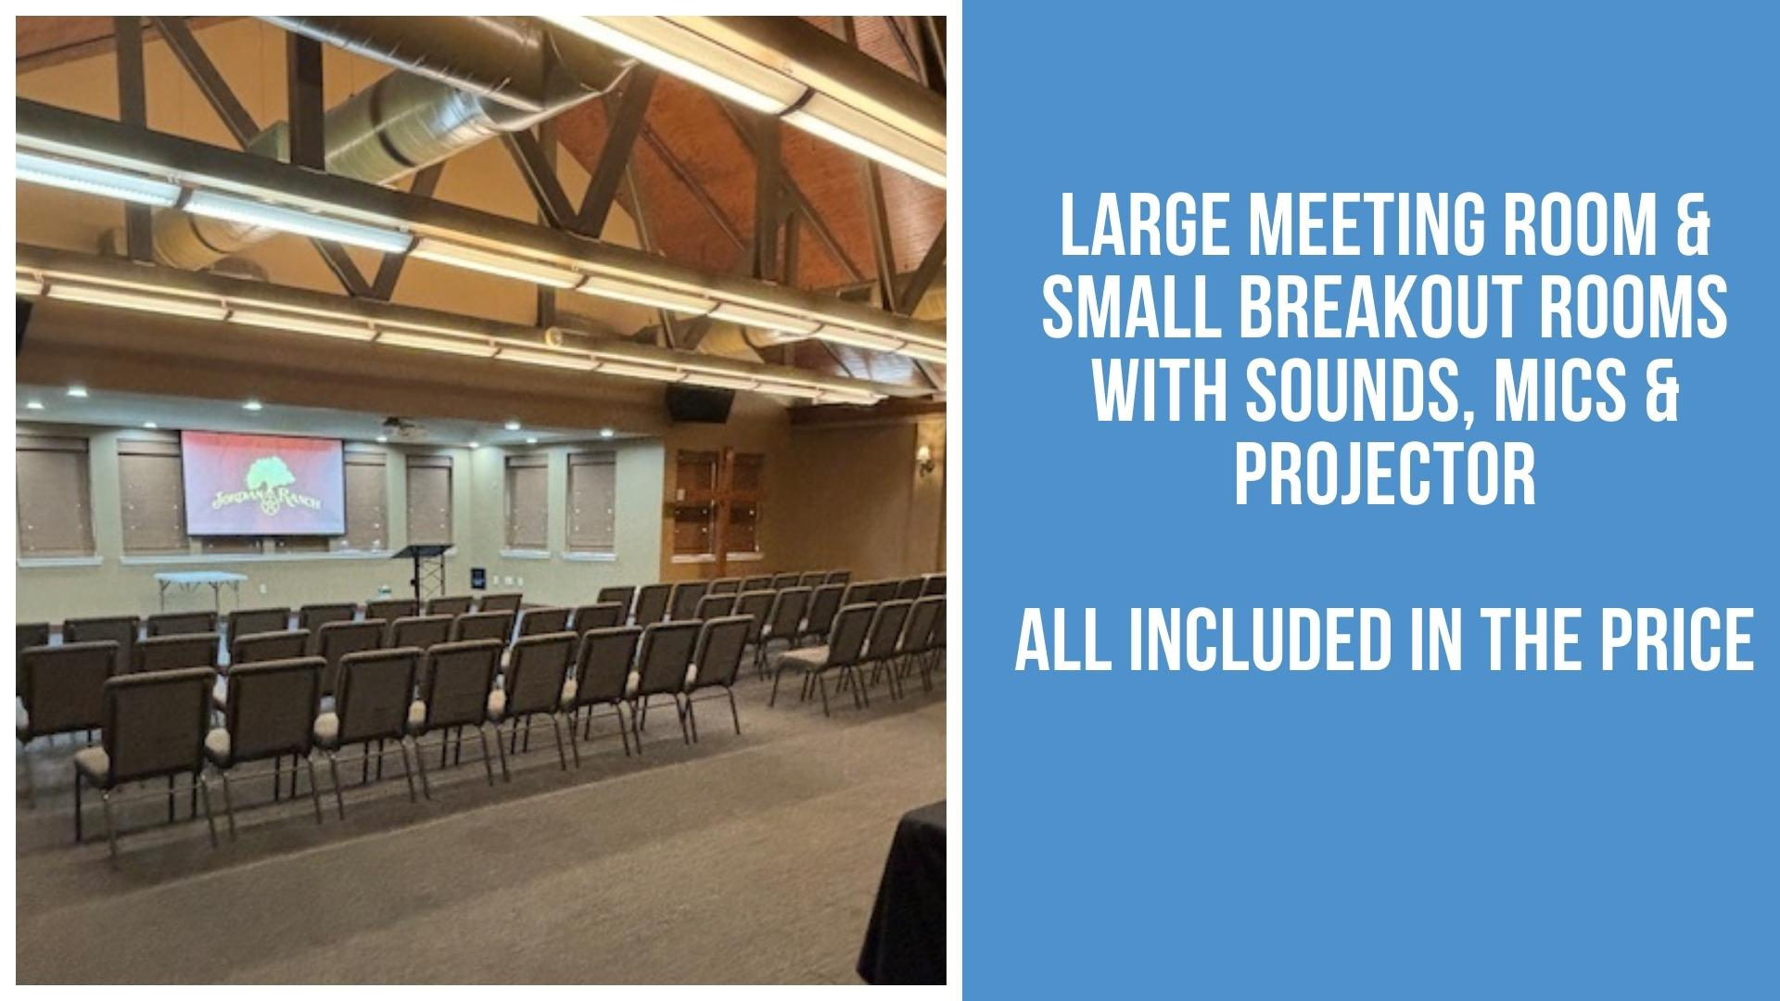
Conference Center
Large Meeting Room & Small Breakout Rooms

Slide 11



ENGAGING RETREAT ACTIVITIES
And more…
Food
Fun
Prayer
Relaxation
Bonding
Worship
Spiritual Rejuvenation
Workshops for growth
Group discussions
Wooded Walking Trails
Participate in interactive workshops that encourage personal and spiritual development together.
Join our thought-provoking discussions to share insights and strengthen community bonds during the retreat.
Experience bonding moments through exciting outdoor activities that inspire teamwork and collaboration.
Notes:
Take pictures from BFF slide

Slide 12
“We Are BFFs: Bold. Fearless. Faithful. Sisters.
Shining A light For Christ”
Retreat experience cost: $400.00
Cost includes
3-days, 2-night stay at Jordan Ranch
Six meals . Breakfast, Lunch, and Dinner by Jordan Ranch Chef
Access to Jordan Ranch amenities: pool, sauna, nature trails
Luxury charter bus, round trip to/from Schulenberg
Impact Church Women's Ministry T-shirt
We Are BFFs retreat materials for workshops and journaling

Slide 13
Deposit $
Beginning
Feb 16
2025 Women’s Ministry Retreat Registration Process
Only 65
Spaces
STEP 1
Deposit Payment Due by: Apr 1
STEP 2
Max Capacity :
65
STEP 3
Registration Form Due: May1
STEP 4
Final Payment
Due by: Jun 1
STEP 5
Final Payment Due by: Jul 1
Make final payment. Up to $300.00; Total $400.00
Women’s Retreat QR code or link used to make payment
QR code and Link will be in Church Newsletter, church website, or Church App PushPay
If paying by check Add “Retreat” in memo line.
Make $100 deposit payment.(minimum)
  Women’s Retreat QR code or link used to make payment
  QR code and Link will be in Church Newsletter, church website, or Church App PushPay
  If paying by check Add “Retreat” in memo line.
Finance team verifies deposit has been received.
  Receives your payment and prepares report of who has paid
  Sends verification report to RPC
  RPC will email each registrant Registration Form
  Deposits will not be accepted once capacity reached
RPC sends registration form to attendee to
complete form with requested information, i.e.,
  Roommate name
  T-Shirt Size
  Allergies
  Food Preferences
  etc.
  Registrant returns completed form by due date
Final Confirmation of registration is when
$400.00 has been paid in full
Registration form has been completed and submitted.
by the first 65 registrants
Confirmation emailed to each registrant.
A Wait List will be generated.
NO REFUNDS
NO REFUNDS
NO REFUNDS
NO REFUNDS
Notes:
Flip due date on top

Slide 14
Questions & Answers

Slide 15
Reach Out To Your RPC Team
For Support and Questions
Ruthie Bass
936-648-6065
Carlean Francois
214-663-2787
Renee Luster
951-807-9951
Yvette Oldacre
703-403-2795

Slide 16
“We Are BFFs: Bold. Fearless. Faithful. Sisters.
Shining A light For Christ”
~Joshua 1:9
Thank you for your interest in our
2025 Women’s Ministry Retreat!

